Slide 1
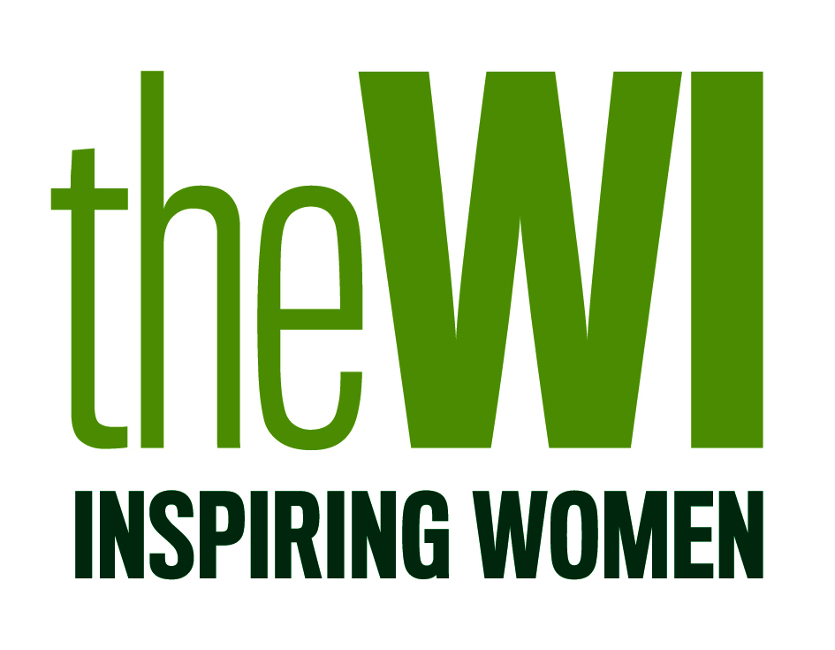
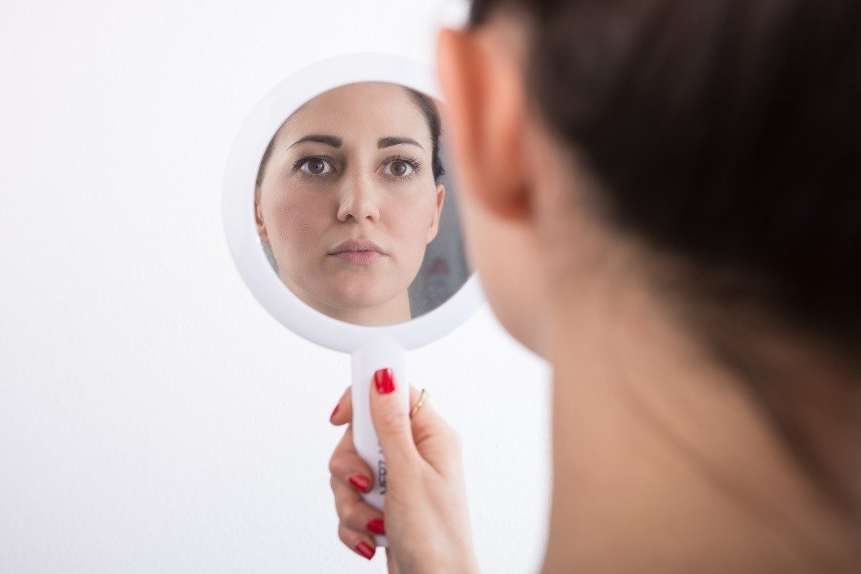
National Federation of Women’s Institutes
Positive body image in a digital age
‘This meeting urges every WI to put pressure on government and the media industry to promote healthy body images and ensure diversity is represented in the media.’
Shutterstock - madeinitaly4k
Notes:
Positive body image in a digital age:‘This meeting urges every WI to put pressure on government and the media industry to promote healthy body images and ensure diversity is represented in the media.’
Click for next slide

Slide 2
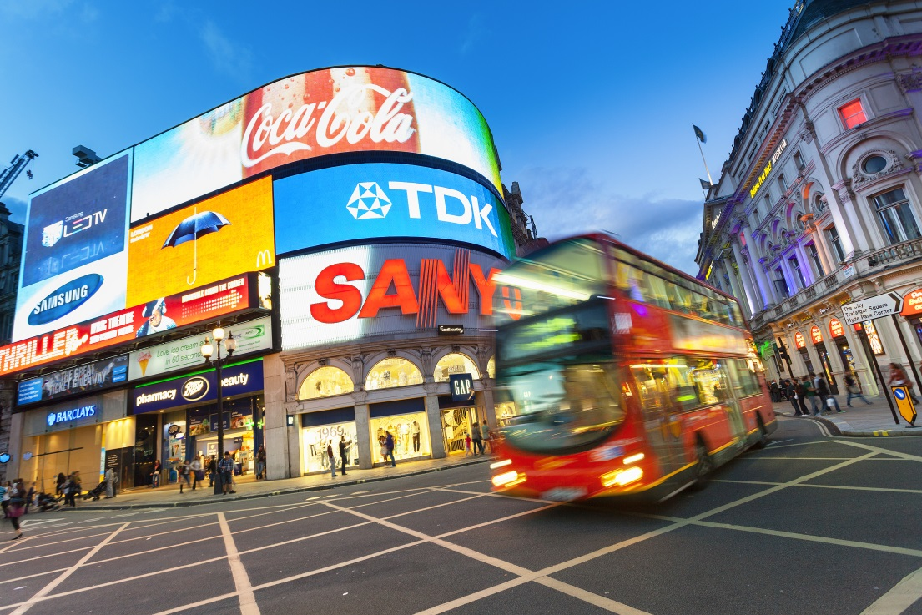
Proposer’s Position
The proposer is concerned with the number of manipulated body images portrayed in the media and wants to see action from the government and industry to promote a healthier body image, as well as ensuring diversity is represented in the media.
Adverts dominate our everyday life, the proposer is concerned about the level of retouching these images receive and the effect this may have on individuals.
Shutterstock - s4svisuals
Notes:
The proposer is concerned with the number of manipulated body images portrayed in the media and wants to see action from the government and industry to promote a healthier body image, as well as ensuring diversity is represented in the media.
Adverts dominate our everyday life, we see them online, in magazines, TV, film and on public transport; the proposer is concerned about the level of retouching these images receive and the effect this may have on individuals.
Click for next slide

Slide 3
What is body image?
Body image can be shaped by:
Media
Family
Friends
Culture
Notes:
Body image can be defined as how people see and feel about themselves. This can be shaped through a variety of ways; media, family, friendship groups and the culture we live in. Two people who could look similar may in fact have very different body image as a result of those influences.
It’s important to note that body image is not static and people may feel differently about their body at different stages in their life and may only feel particularly low in confidence in one aspect of their appearance.
Click for next slide

Slide 4
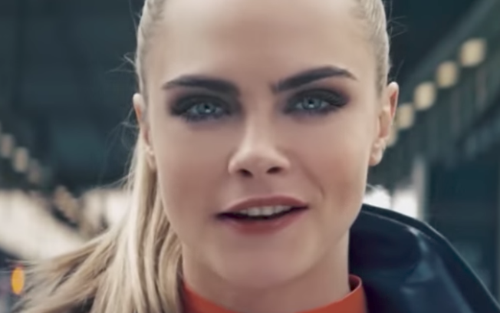
How can photos be manipulated?
Banned L’Oreal and Rimmel adverts
Zendaya heavily edited image for Modeliste
Model Filippa Hamilton
Notes:
The 1980s saw the technique of airbrushing developed to digital editing, software programmes such as Photoshop allow individuals to edit photographs in a particular way. Manipulation of photographs can include removing moles, blemishes or dramatically altering facial and body features.
In 2011 the Advertising Standards Authority banned L’Oreal’s adverts that featured actress Julia Roberts for exaggerating the images and breaching its code of conduct. Most recently, in April 2017 a Rimmel mascara advert featuring model Cara Delevingne was banned for manipulating too heavily with post-production techniques including airbrushing.
Female public figures have called out publications that have heavily altered and Photoshopped their appearance. American actress and singer, Zendaya posted a side-by-side comparison of the real and retouched photo of herself in magazine Modeliste, which showed her hips, chest and hair colour had been manipulated.
There are also concerns about social media’s role in promoting positive body image; many young people use platforms such as Facebook, Instagram and Snapchat to get instant approval and gratification in the form of ‘likes’ and comments from images uploaded online. These images can be edited, cropped and filtered to alter the original image. Whilst magazines and TV adverts have to be either bought or are controlled for a certain period of time, social media is unlimited.
Click for next slide

Slide 5
What is the impact on individuals?
37% of girls aged 11-21 say they compare themselves to celebrities most of the time or often.
The three main sources of pressure on secondary school boys to ‘look good’ were social media, advertising and celebrities.
Shutterstock – Andrea Raffin
Notes:
Poor body image can result in low self-esteem, eating disorders and cosmetic surgery to change the way a person looks and affects both boys and girls and all ages.
37% of girls aged 11-21 say they compare themselves to celebrities most of the time or often and 47% of young women agreed with the statement ‘seeing adverts using thin models makes me want to diet/lose weight/feel more conscious of the way I look’.
Images of muscles and a toned physique can put pressure on boys to have a ‘perfect’ body. Research found that the three main sources of pressure on secondary school boys to ‘look good’ were social media, advertising and celebrities.
There are also concerns about social media’s role in promoting positive body image; many young people use platforms such as Facebook, Instagram and Snapchat to get instant approval in the form of ‘likes’. These images can be edited, cropped and filtered to alter the original image.
Click for next slide

Slide 6
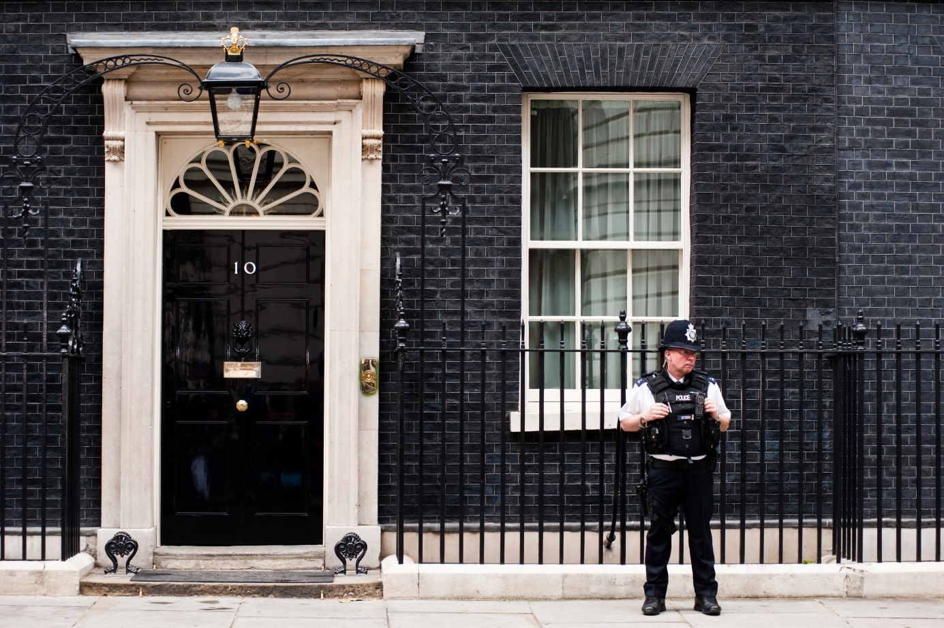
How has the issue been tackled so far?
pcruciatti/Shutterstock.com
Notes:
The government established a body confidence campaign in 2010 which aimed to raise awareness of body image issues and work with industry to tackle causes of negative body image. Liberal Democrat MP Jo Swinson, campaigned heavily on the issue of body confidence; she hosted a number of roundtables on various aspects of body image.
As part of the project and following the Reflections on Body Image report from the All-Party Parliamentary Group on Body Image, the organisation Be Real was launched in 2014 and acts as a hub to link partners and the public on their activities on body image. Be Real features resources, toolkits and workshops for schools to promote positive body image.
The Advertising Standards Authority announced in July 2017 that they will toughen their rules on adverts that feature airbrushing and those that ‘perpetuate sexist stereotypes’, as well as banning adverts that feature ‘unhealthily thin’ models
Click for next slide

Slide 7
Diversity in the media
Women account for 48% of employees across the TV industry compared to 51% of the UK population
Disabled employees make up just 3% of employees across the TV industry compared to 18% of the UK population
Only 45% of BAME respondents agree that advertising represents the UK’s multicultural society
Notes:
The media industry represents the communication channels through which news, entertainment, education or promotional messages are distributed and includes television, radio, newspapers, magazines, cinema, recorded music and social media.
Relating to the TV industry, an Ofcom report from September 2017 found that women, ethnic minority groups and disabled people were all under-represented. Women account for 48% of employees across the five main broadcasters versus 51% of the UK population and disabled employees make up just 3% of employees compared to 18% of the UK population.
Ofcom outlined a number of ways broadcasters could improve which included regularly monitoring the make-up of their workforce, setting clear diversity targets and embedding diversity from the top down.
Advertising Association’s think thank Credos undertook research into how advertising portrays diversity in Britain and found that only 45% of BAME respondents agreed that advertising represents the UK’s multicultural society.

Slide 8
How could the WI work on this resolution if it passed?
At a national level the WI could add its voice to the Be Real campaign and put pressure on the industry and government to make more significant changes.
At a regional level federations could hold body confidence sessions and training on how to confront these issues with children, grandchildren and friends.
At a local level WIs could raise awareness of the issue in their local community and highlight what they think needs to change within the industry. WIs could also write to their local media calling for more equal representation.
Notes:
A full campaign plan would be developed by the NFWI if the resolution is passed, taking into account developments since then. But to help inform your discussions, here are some ways the WI could consider working on this issue if it was passed.
At a national level the WI could add its voice to the Be Real campaign and put pressure on the industry and government to make more significant changes.
At a regional level federations could hold body confidence sessions and training on how to confront these issues with children, grandchildren and friends.
At a local level WIs could raise awareness of the issue in their local community and highlight what they think needs to change within the industry. WIs could also write to their local media calling for more equal representation.
Click for next slide

Slide 9
Arguments for the resolution
The call to action is clear and broad, meaning it would enable the NFWI to work on promoting healthier body images for men and women and greater diversity in the media
The resolution is timely with the ongoing rise and interest in celebrity culture and social media. The WI could add a strong voice to these discussions
Notes:
The call to action is clear and broad, meaning it would enable the NFWI to work on promoting healthier body images for men and women and greater diversity in the media.
The resolution is timely with the ongoing rise and interest in celebrity culture and social media. The WI could add a strong voice to these discussions.
Click for next slide

Slide 10
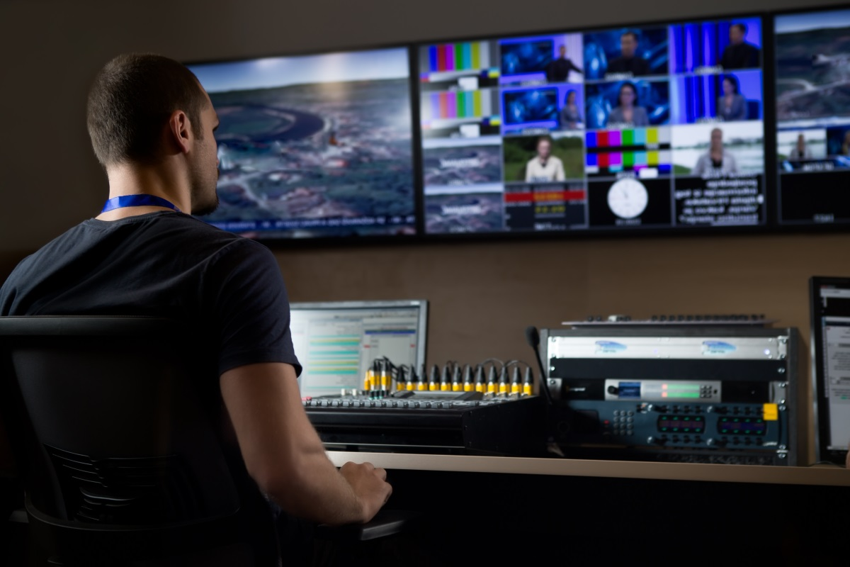
Arguments against the resolution
The new guidance from the Advertising Standards Authority aims to address some of the problems with advertising.
Shutterstock -eldar nurkovic
Notes:
Following the Advertising Standards Authorities announcement on toughening their rules on adverts, is there more the WI could add on this particular topic?
Click for next slide

Slide 11
Video clip on the issue
Ted Talk: Meaghan Ramsey ‘Why thinking you're ugly is bad for you’
https://www.youtube.com/watch?time_continue=722&v=gXlIAS-rI4E
Notes:
(Video will only appear when in slideshow mode. Click the red button to play the video.)

Slide 12
Further information
Be Real https://www.berealcampaign.co.uk/
T: 020 7186 9552
E: bereal@ymca.org.uk
Girl Guiding https://www.girlguiding.org.uk/
T: 0207 834 6242
To receive monthly NFWI campaign updates please sign up via the campaigns area of the website
Advertising Association https://www.adassoc.org.uk/knowledge/
T: 020 7340 1100
E: aa@adassoc.org.uk
Public Affairs Department
Email: pa@nfwi.org.uk Phone: 020 7371 9300 ext 238
Post: 104 New Kings Road, London SW6 4LY
Notes:
To receive monthly NFWI campaign updates please sign up via the campaigns area of the website.
End of PowerPoint

