Slide 1
Raising awareness of modern slavery in the UK
National Federation of Women’s Institutes
Resolution Shortlist
Modern slavery affects thousands of people in the UK every year, and leaves them facing servitude, forced or compulsory labour, sexual exploitation and human trafficking. This meeting calls on every WI and the NFWI to raise awareness of this important issue and to lobby for more effective support for the physical and psychological health of victims of this crime.
Notes:
[Read out the motion and the title]
The proposer of this resolution is concerned that modern slavery is a growing problem in the UK and worldwide.
The resolution aims to encourage and empower every WI member to raise awareness of the issue, learn about the signs of modern slavery and push for more support for those affected.

Slide 2
Outline of presentation
What is modern slavery?
The scale of the problem
The current situation in the UK
How could the WI work on this resolution if it was passed?
Arguments for the resolution
Arguments against the resolution
Further information
Notes:
[Read from the slide]

Slide 3
What is modern slavery?
Modern slavery is a complex crime that takes a number of different forms. It includes;
Slavery
Servitude
Forced and compulsory labour
Human trafficking
Traffickers and slave drivers coerce, deceive and force individuals into a life of abuse, servitude and inhumane treatment.
Victims may be sexually exploited, forced to work for little or no pay or forced to commit criminal activities against their will.
Notes:
[Read from the slide]

Slide 4
The scale of the problem
Modern slavery crimes are being committed across the UK in many different sectors including;
Factories
Fields
Brothels
Nail bars
Within people’s homes
It is estimated there between 10,000 and 13,000 victims currently in the UK, and up to 45 million worldwide.
There is no typical victim of slavery – they can be men, women or children of all ages and nationalities.
Notes:
[Read from the slide]

Slide 5
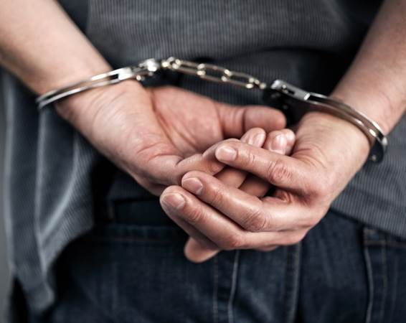
The current situation in the UK
2015 – Modern Slavery Act passed
The Act has been criticised for focusing too heavily on policing and not providing proper protection for victims:
Protection and support for victims is patchy.
No system of long-term support for victims, many have to move out of safe houses before they are recovered.
Police need more resources to investigate modern slavery crimes.
Still cases where victims are not believed or are treated as criminals.
Notes:
In 2015 the UK passed the Modern Slavery Act which made a number of changes to make prosecuting traffickers easier and to increase sentences for those crimes.
It also requires big businesses to report on how they tackle slavery in their global supply chains and established a UK Anti-Slavery Commissioner to oversee the UK’s policies.
However, the Act has been criticised for focusing too heavily on policing and not providing protection for victims.
Protection and support for victims is patchy and there is no system of long-term support for them.
There are still cases where victims are not believed or are treated as criminals.
The police also need more resources to investigate these crimes.

Slide 6
The current situation in the UK
Spring 2017 – A committee of MPs called for government action to ensure that victims of modern slavery get the support they need.
October 2017 – the government launched the Business Against Slavery Forum.
October 2017 – the Salvation Army reported at 300% increase in the number of victims of modern slavery requiring support.
Notes:
In spring 2017 the Work and Pensions Committee in Parliament found support for victims lacking. It found that some victims face destitution or even a return to their enslavers because they cannot access ongoing support.
Their report called for victims to be allowed longer to recover, to receive financial support and that they should not be required to leave safe house accommodation until a plan for ongoing support is put in place.
In October the government launched the Business Against Slavery Forum which aims to speed up business action to remove slavery from supply chains.
The Salvation Army, which is contracted to provide support to victims of modern slavery found a 300% increase in the number of victims who needed support.

Slide 7
How could the WI work on this resolution if it was passed?
At a national level
The WI could work with other organisations to push for government action to better safeguard and support victims and survivors of this crime.
At a local and regional level
Members could learn about the issue, raise awareness locally, and understand how to report concerns.
They could push police forces, their Police and Crime Commissioner and local agencies to ensure they are supporting victims.
Notes:
A full campaign plan would be developed by the NFWI if the resolution is passed, taking into account developments since then.
Here are some ways the WI could consider working on this issue if it was passed.
[Read out points from the slide]

Slide 8
Arguments for the resolution
This resolution could positively complement the WI’s past work on violence against women and trafficking.
The WI could help build awareness and action on an issue that is currently not widely understood or publicised.
Notes:
There are various arguments for the resolution, which we can debate after this presentation.
Two main ones are [read slide]

Slide 9
Arguments against the resolution
There has been an increasing national and international focus on modern slavery. Is enough being done already?
Due to the sensitive nature of the issue, there could be limited opportunities for the NFWI to undertake research on this issue.
Notes:
And here are the arguments against the resolution [read slide]

Slide 10
Further information
NFWI Public Affairs Department:
E: pa@nfwi.org.uk T: 020 7371 9300
https://www.thewi.org.uk/campaigns
Anti-Slavery International
www.antislavery.org
T: 020 7501 8920
E: info@antislavery.org
Unseen
www.unseen.org
Salvation Army
www.salvationarmy.org.uk
T: 020 7367 4500
E: info@salvationarmy.org.uk

