Slide 1
National Federation of Women’s Institutes
Resolution Shortlist
November 2016
Plastic soup: Keep microplastic fibres out of our oceans.
‘Microplastic fibres are shed from synthetic clothing with every wash and are the main contributors to microplastic contamination of the oceans. The NFWI calls on government and industry to research and develop innovative solutions to this problem in order to stop the accumulation of microplastic fibres in our oceans
Place image here
Place image here
Notes:
[Read out title and wording of the resolution]
The proposer of this resolution is concerned about the amount of microplastic fibres that are entering our oceans and the impact this has on aquatic life. With 85% of human-made material on the shoreline consisting of microplastic fibres, the proposer believes that the WI has an important role to play in raising awareness. She wishes to see the WI use its influence to encourage government to support and fund research and development into water treatment, textile production and recycling equipment and processes, as well as to persuade washing machine manufacturers to introduce filters to reduce the numbers of microplastic fibres entering the ocean.

Slide 2
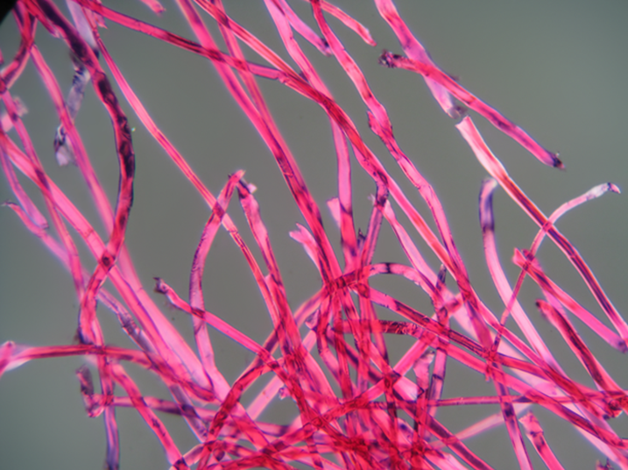
Outline of presentation
What are microplastic fibres?
Why are they a problem?
What can be done to tackle the issue?
Government approach
How the WI could work on this resolution
Arguments for, arguments against
Shutterstock.com
Notes:
This resolution addresses an issue which is largely hidden but which has a potentially huge impact on our natural environment.
First I will talk through what microfibres are
Then I will discuss why they are a problem
How the problem can potentially be tackled
I will go on to give a brief overview of the current government attitude to the problem
Then I’ll discuss how the WI could possibly work on this resolution if it were to pass
And then round off the discussion with some key arguments for and against the motion

Slide 3
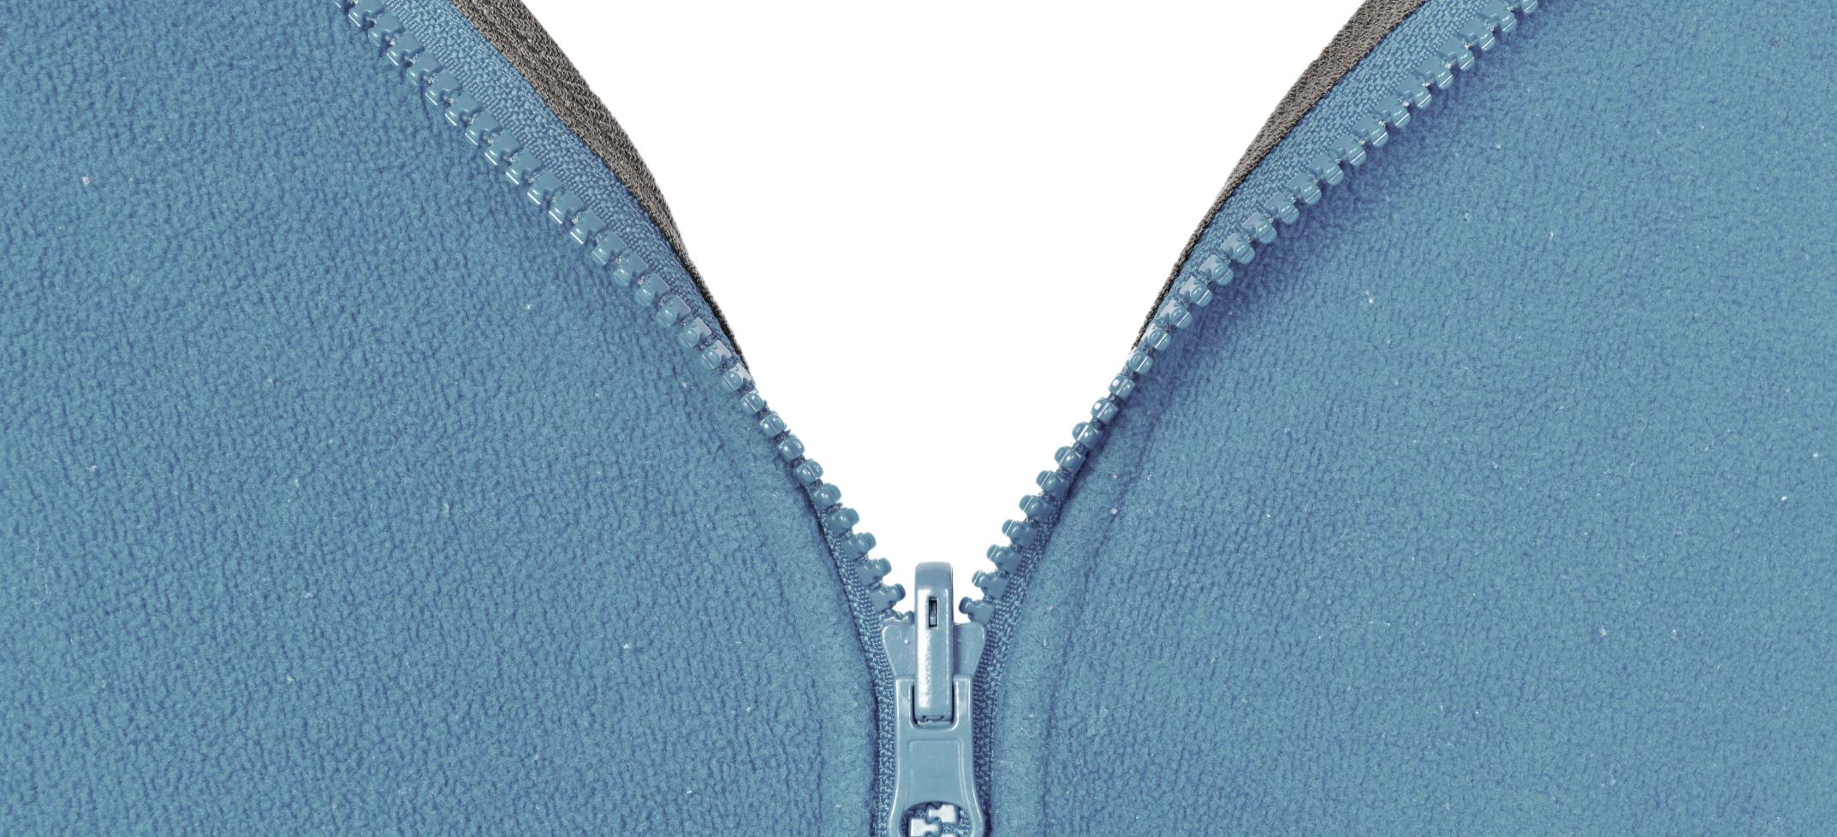
What are microplastic fibres?
85% of human-made materials on the coastline consist of microplastic fibres
“…shed from synthetic and man-made clothes when laundered and end up in the sea and wider environment…”
1,900 microfibres rinsed off a single synthetic garment
Shutterstock.com
Notes:
The National Oceanic and Atmospheric Administration defines microplastics as plastic fragments 5mm or smaller.
Microplastic fibres are shed from synthetic and man-made clothes when laundered and end up in the sea and wider environment.
A report by ecologist Mark Browne estimated that around 1,900 individual microfibers can be rinsed off a single synthetic garment
With around 85% of human-made materials found on the coastline consisting of microplastic fibres.
A report by the International Union for the Conservation of Nature estimates that 1.5 million tons of microplastics are released into the ocean every year. This is the equivalent to one empty plastic carrier bag being thrown into the ocean per person per week worldwide.
The study found that the largest proportion of microplastic particles came from the abrasion of tyres while driving, and laundering of synthetic textiles. These particles end up in the environment through road run off, waste water treatment systems and wind transfer.

Slide 4
Plymouth University study
140,000 fibres from polycotton fabric
730,000 fibres from acrylic
Type of detergent has an impact on shed
All images: Shutterstock.com
Notes:
A study by Plymouth University showed that a number of factors influenced the number of microfibres shed from a piece of clothing.
This included the type of fabric – for example, 140,000 fibres were shed per washing machine load of polyester-cotton blend fabric click compared with 730,000 fibres for acrylic. click
The same study found that the type of detergent used, and whether or not fabric conditioner was used, also had an impact on the number of fibres that were shed. click
The research into microplastic fibres, how they are released and where and how they accumulate is still in its relative infancy. In an inquiry into microplastic pollution, the parliamentary Environmental Audit Select Committee recognised this issue, and recommended that the government should seek to formulate a policy for researching and mitigating the impacts of microplastic fibres from an early stage.

Slide 5
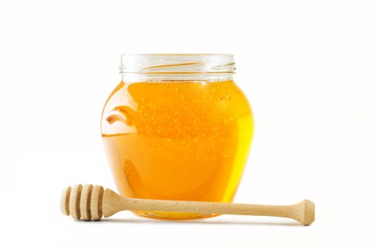
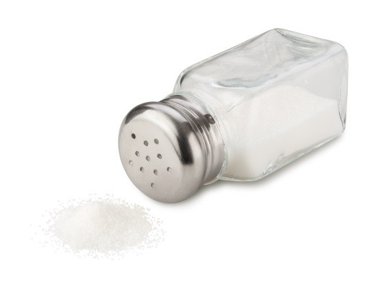
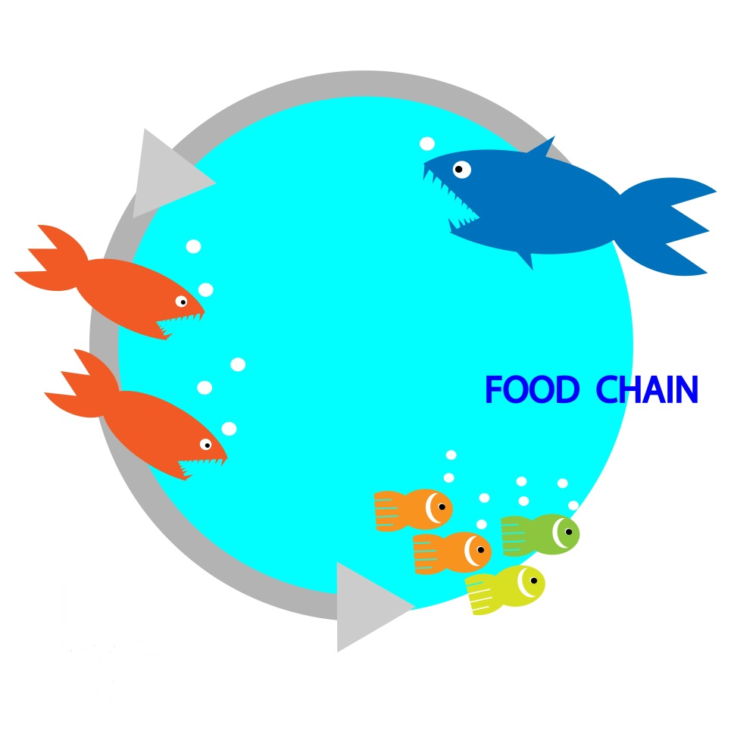
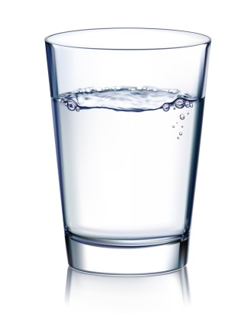
Why are microfibres a problem?
Microplastics soak up toxins and end up in the food chain concentrating toxins in larger sealife.
They can end up in the human diet, with potential impacts on human health.
In an era of ‘fast fashion’ where people are buying and consuming more clothes, the problem is only likely to get worse.
Found in 25%
of fish
All images: Shutterstock.com
Notes:
Microplastics soak up toxins and due to their small size microplastic fibres are readily ingested by aquatic life
As they bioaccumulate through the food chain, they concentrate toxins in the bodies of larger animals.
There is currently a lack of research into how much of these particles and toxins end up in the human diet, and what impacts these will have on health.
However a study looking at fish sold in markets in California and Indonesia found that a quarter had plastic fibres and debris in their guts.
They’ve also been found in drinking water, honey, and table salt
The Environmental Investigation Agency state that there is a clear risk that they could pose a threat to health, with several NGO’s recommending that a precautionary approach should be taken.
And the problem is only likely to get worse.
Synthetic material is commonly found in outdoor activity clothes and in the ‘fast fashion’ industry.
Between 2009 and 2013, global consumption of synthetic clothing and textiles increased from 35.8 million tonnes to 55 million tonnes.

Slide 6
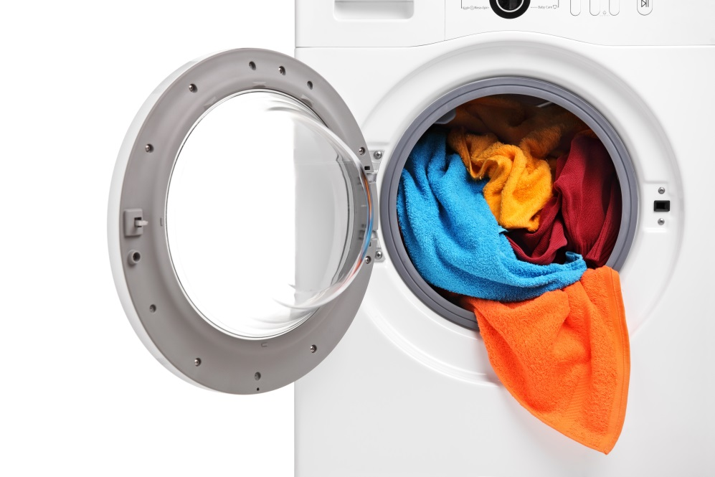
What can be done to tackle the issue?
Prevention is key
Need to tackle ‘at source’
There are existing innovations that could be applied
Critically… Further research and development is needed.
All images: Shutterstock.com
Notes:
Once in the marine environment, any attempt to remove microfibres would be time and labour intensive and extremely costly, therefore prevention is key.
Fitting filters to waste water treatment plants is an option, however due to microfibres entering sewage sludge in the treatment process it is likely that this method of filtering would still result in microfibres in the wider environment. It would also be very costly - though this should be investigated.
Because of this, at source is generally considered to be the most effective way of reducing microfibres entering the environment. Fitting filters to new washing machines and retrofitting filters to old washing machines is one option for tackling the problem,
however with this approach, we need to ensure that consumers dispose of the filtered fibres correctly otherwise they could end up in the wider environment anyway!
Fabrics coated with an anti-shed treatment, a ‘nanoball’ used in the washing machine to attract and capture plastic, and washing using certain detergents are other options. The EU Mermaids project is looking at ways that existing technology can be utilised to alleviate the problem.
As I mentioned earlier in the presentation, the influential parliamentary Environmental Audit Committee looked at this issue earlier this year.
Critically, they highlighted the need for more research and development, and that government should be looking at this issue from an early stage.

Slide 7
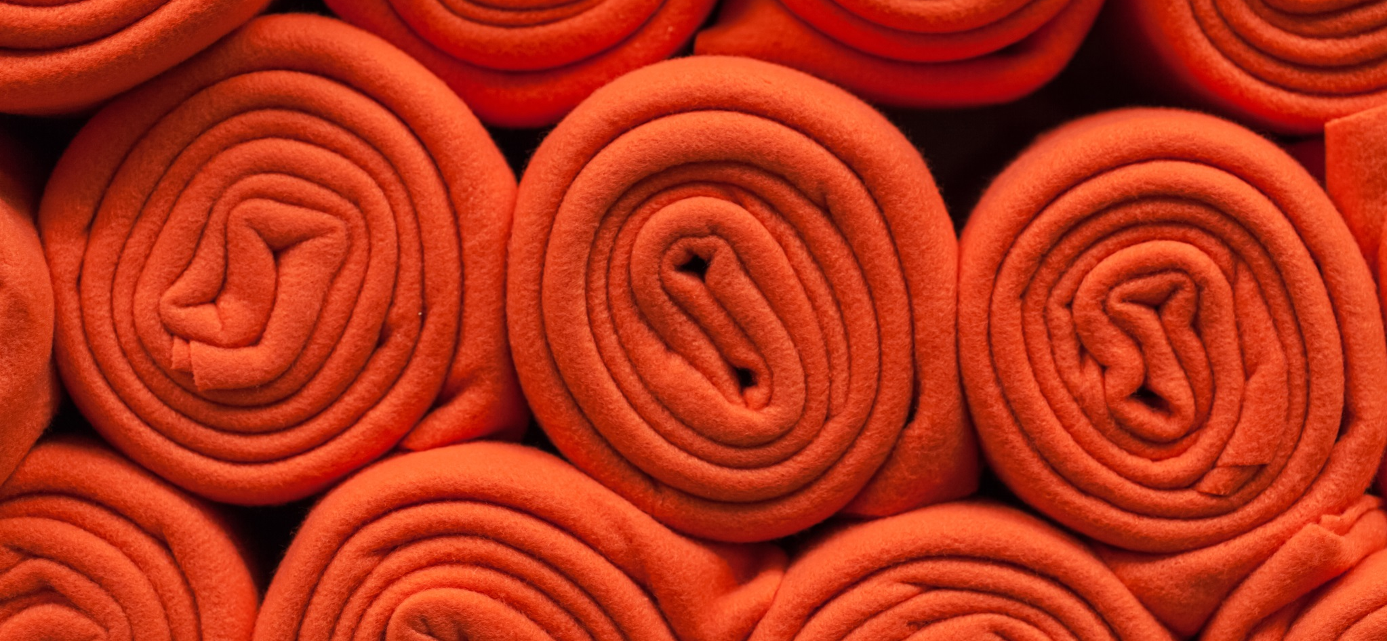
Government approach
Has committed to banning microbeads
A first step towards considering other microplastic pollution?
Shutterstock.com
Notes:
In November the UK government responded to the inquiry into microplastics. It stated that the Chief Medical Officer would review the health impacts of microplastics, and that it would shortly be publishing a report on the potential harm of microplastics in the marine environment.
In March 2017 the Environment Agency, water industry and academics came together to look at the role of wastewater treatment in the release of microplastics into the environment. They proposed that the water industry should trial sampling for microplastics at their wastewater treatment plants during this year. The results of this investigation programme would feed into decisions about what to do next.
The government has also committed to banning microbeads – a type of microplastic commonly found in cosmetics and toiletries (but which are much less common than microplastic fibres). This is a change in approach for the government which previously supported a voluntary phase out. The ban is an important first step in reducing microplastics in the oceans. Given this change in approach, government may be more responsive to considering other ways of mitigating microplastic fibre pollution.

Slide 8
How the WI could work on this resolution
At a national level, the NFWI could work with environmental charities to bring what is currently a fairly niche issue into the mainstream.
Press government, industry and the Research Councils to set aside funding to research the problem and develop solutions.
Better filtration systems on waste water treatment plants and incentives for consumers to invest in technology which reduces the problem could be longer term aims.
At a local level, WI members could use their collective consumer power to seek greater action on the issue from clothing and washing machine manufactures.
Emphasise that consumers are willing and able to ensure that microfibres are tackled at source.
Notes:
At a national level the NFWI could work with environmental charities to bring what is currently a fairly niche issue into the mainstream.
Better public and political awareness of the issue would provide a good foundation from which the NFWI could press government, industry and the Research Councils to set aside funding to research the problem and develop solutions.
Calling for better filtration systems to be fitted to waste water treatment plants and incentives for consumers to invest in technology (where it exists) which reduces the problem could be longer term aims.
At a local level WI members could use their collective consumer power to seek greater action on the issue from clothing and washing machine manufactures.
They could emphasise the fact that, when made aware of the information and extent of the problem, consumers are willing and able to ensure that microfibres are tackled at source.

Slide 9
Arguments for the resolution
This resolution is in keeping with the WI’s longstanding concern for sustainable marine environments and members’ tradition of taking action on issues at consumer and household level.
This is an issue which is not currently widely understood or publicised, and is one which the parliamentary Environmental Audit Committee has recommended decisive action as part of its investigation into microplastics. The WI could help bring attention to the issue and encourage the government and industry to make it a priority.
Notes:
[read the text on the slide]

Slide 10
Arguments against the resolution
The research into this area is still in its relative infancy – do we know enough about the issue to take action?
This is a huge problem and would require input from a number of stakeholders, including consumer buy-in. It could also be very costly – is it achievable, and can the WI make a difference?
Notes:
[read the text on the slide]

Slide 11
Further information
NFWI Public Affairs Department
E: pa@nfwi.org.uk T: 020 7371 9300
https://www.thewi.org.uk/campaigns
Marine Conservation Society: www.mcsuk.org/
The MERMAIDS project: http://life-mermaids.eu/en/
Plastic Soup Foundation: www.plasticsoupfoundation.org/en/

