Slide 1
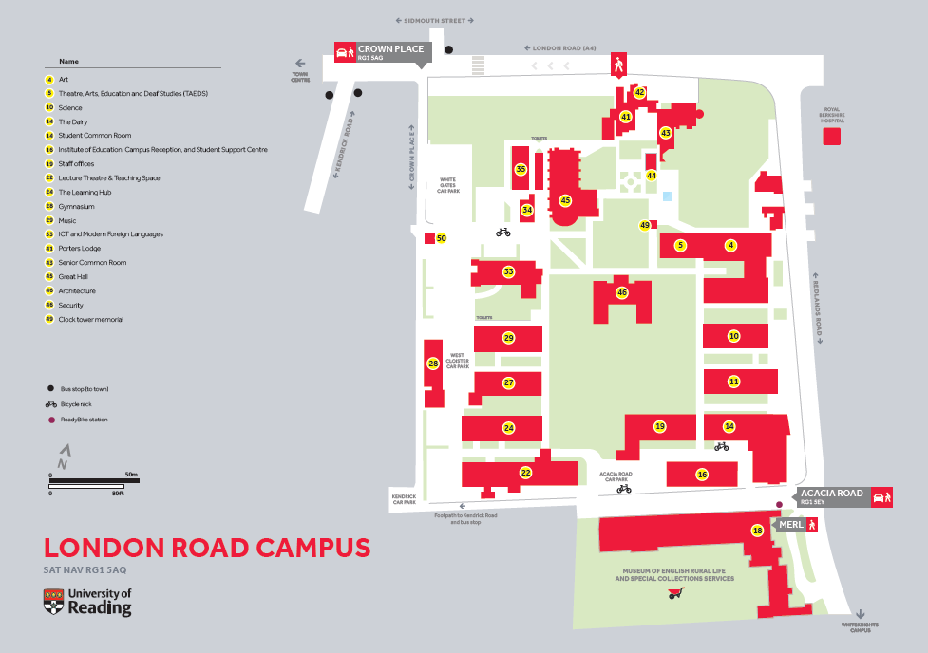
Bus 21 Reading
Bus 3B Wokingham/Bracknell
The Great Hall
The Dairy Café for drinks/food. Please note CARD only no Cash

